Slide 1
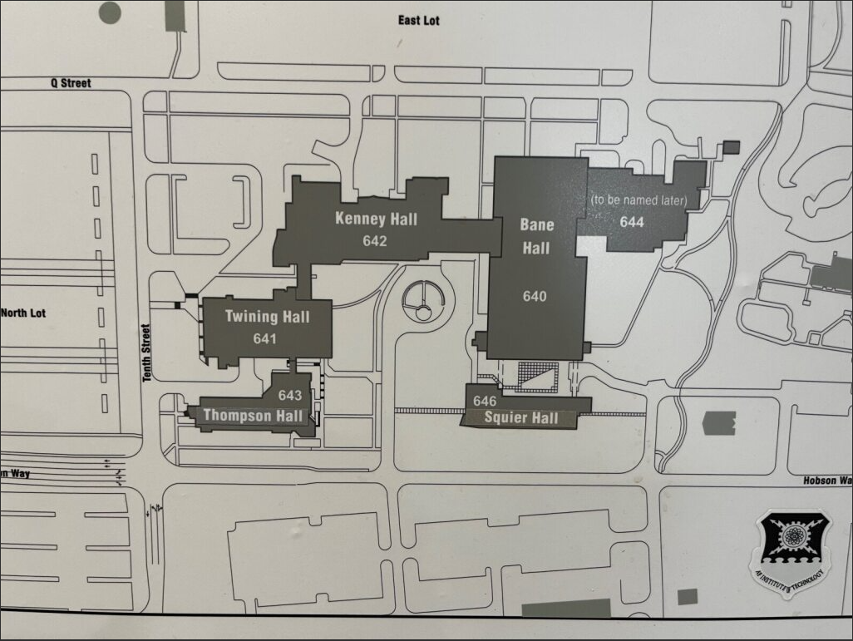
AFIT MAP
2nd Annual DMM Symposium
Event Parking
USE ENTRANCE BY DUNKIN DONUTS
Primary Location – Kenney Hall Auditorium
Secondary Location – Bane Hall Auditorium
Address: 2950 Hobson Way, Wright-Patterson AFB, OH 45433
**Signs will be in place to direct you to DMM Symposium locations**

